Slide 1
Biology 101: Ecosystems
SECTION 2
DR. ANAND
APRIL 28, 2017

Slide 2
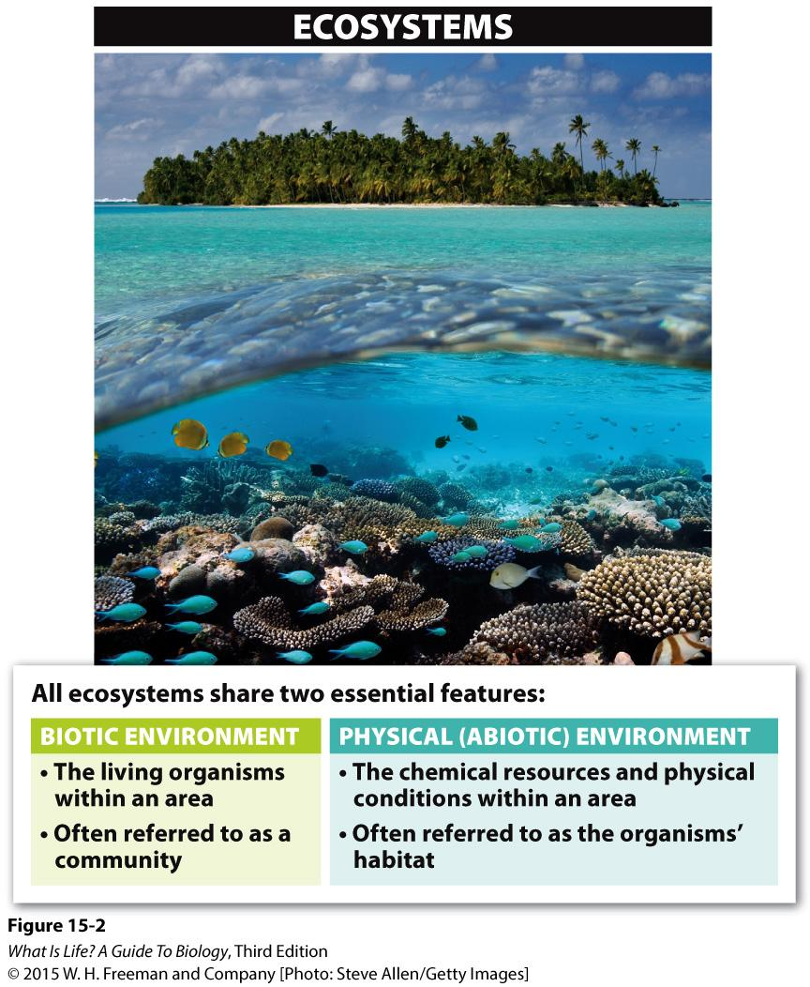
Ecosystems
The study of ecosystems focuses on the interactions between two elements:
The community of all living organisms in an area
The chemical resources & physical conditions (the non-living elements) that form the habitat

Slide 3
THE ECOLOGICAL NICHE
It is more than just the physical place (‘address’) where a species lives, it also includes its role in the system (its “occupation / lifestyle”).
The Ecological Niche is a multidimensional concept that includes where an organism lives AND also includes what it does, how it does it, when it does it, etc. It is its total role in the ecosystem.

Slide 4
‘TYPES’ OF NICHE
Fundamental or Hypothetical
the total range of physical, chemical and biological factors a species can utilize / survive if there are no other species affecting it
Realized or Actual
that portion of the fundamental niche that a species actually uses.
Species never live under ‘perfect’ conditions but where an ‘acceptable’ ECOLOGIC SUM of conditions exists.

Slide 5
NICHE EXCLUSION PRINCIPLE (= Competitive Exclusion Principle) (= Gause’s Law)
In a stable community no two species can occupy the same niche
That is to say, no two species can coexist if they need all the same things in the same place, at the same time, etc.
The greater the degree of niche overlap, the greater the competition for scarce resources AND the more likely one species will eliminate the other.

Slide 6
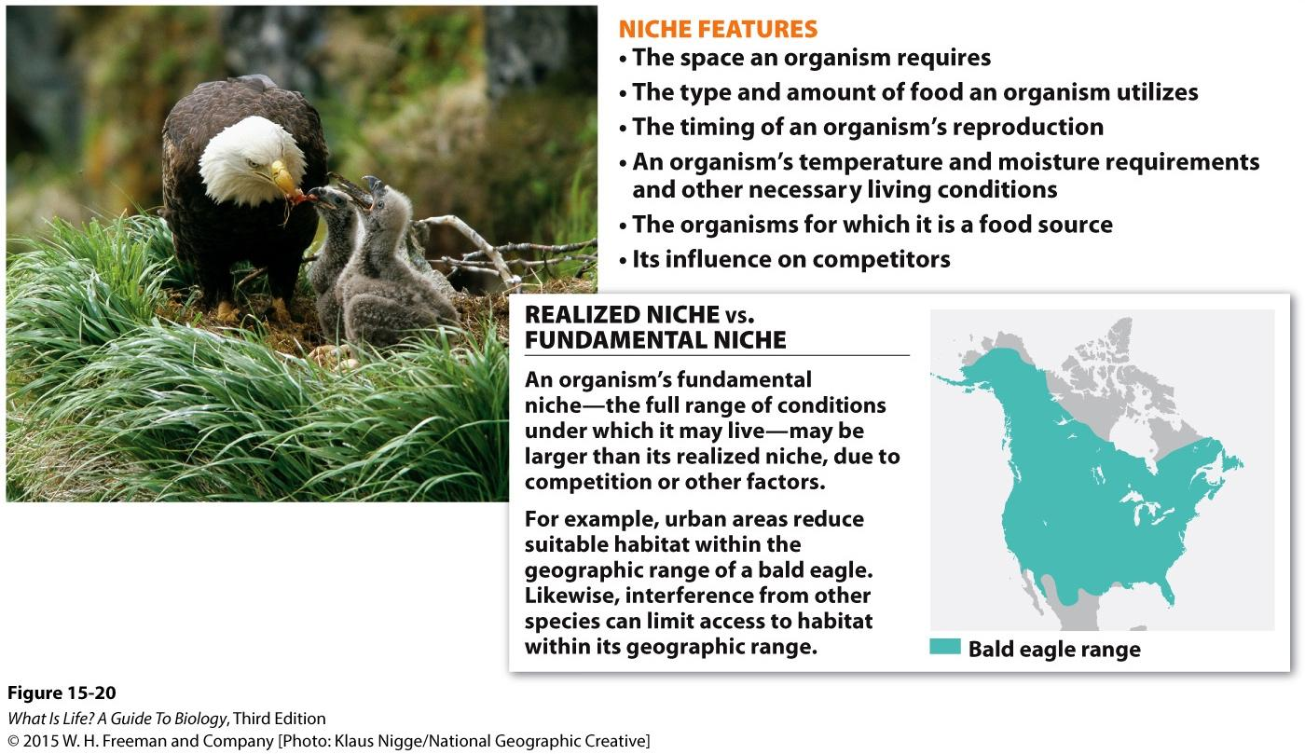
Niche Summary
Habitats have varying numbers of possible niches
Habitat requirements for an organism define where it can live (fundamental niche)
Geographic area where fundamental niches are found is called an organism’s range
Realized niche is the subset of possible habitat where an organism does live
Generally, only one species in an ecosystem fills a particular niche
More niches = Greater biodiversity
Notes:
Different biomes have varying numbers of possible niches
The

Slide 7
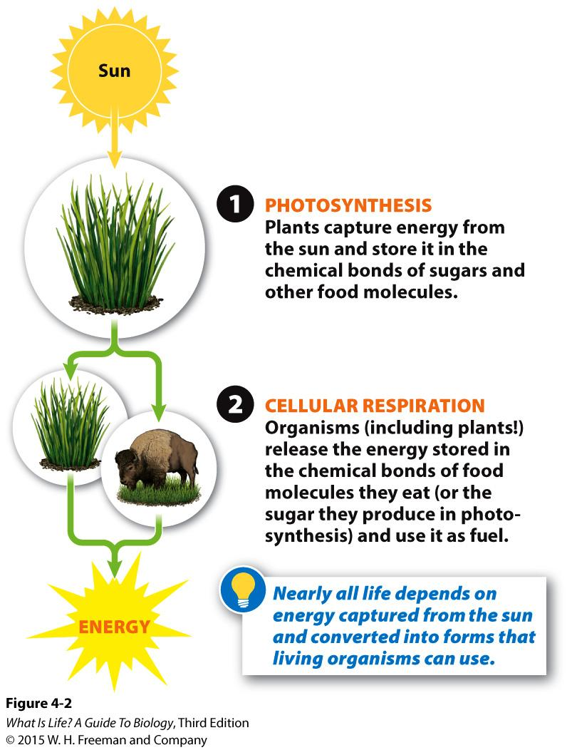
Life Runs on Solar Energy
The Sun serves as the ultimate source of energy for most (not all) life on Earth
Two biological processes capture & release energy:
Photosynthesis → Energy capture
Only plants & plant-like protists
Cellular Respiration → Energy release
ALL living organisms

Slide 8
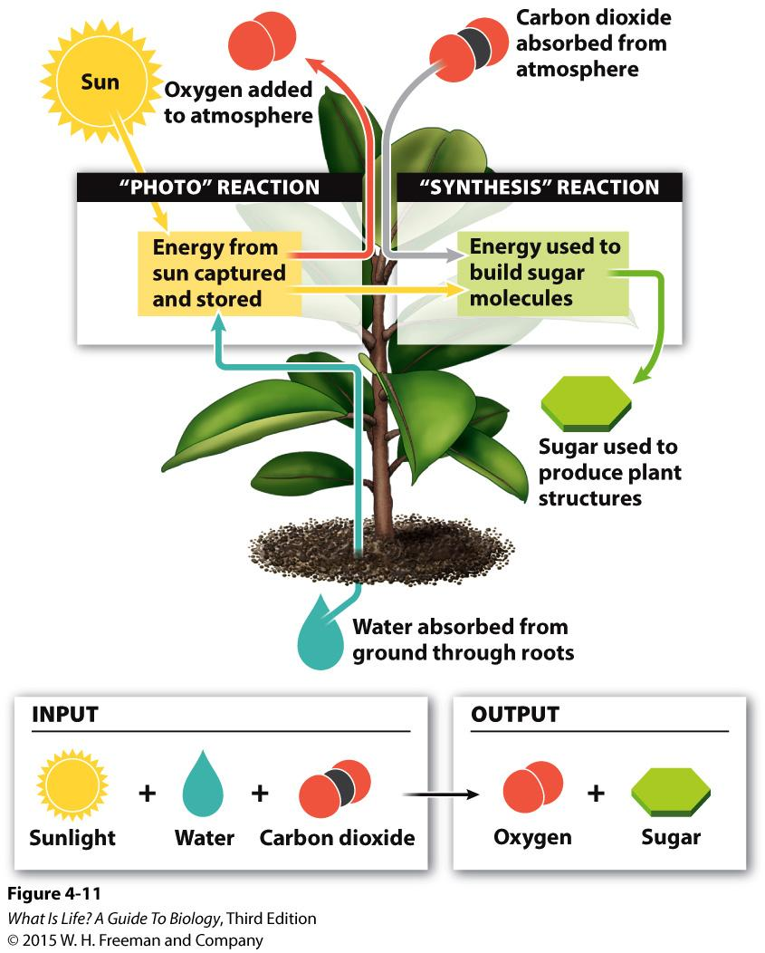
Photosynthesis
Process by which light energy from the Sun is converted into chemical energy in sugar
“Photo” reaction uses light energy to break apart water, releasing oxygen
Energy absorbed in the “photo” reaction is used in the “synthesis” reaction to convert carbon dioxide into sugar
Occurs in the chloroplasts

Slide 9
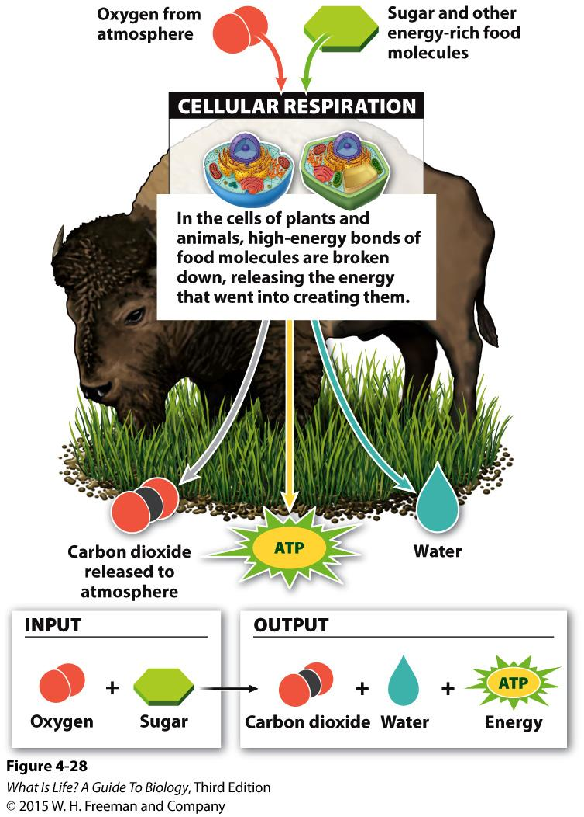
Cellular Respiration
Process by which chemical energy in sugar is released to allow the cell to perform work
Sugars (and other molecules that are ultimately synthesized using the energy stored in sugars) are broken down using oxygen
Process releases carbon dioxide & water, as well as the ATP molecules cells use for energy
Occurs in the mitochondria

Slide 10
Cyclic Process
Photosynthesis
Cellular Respiration

Slide 11
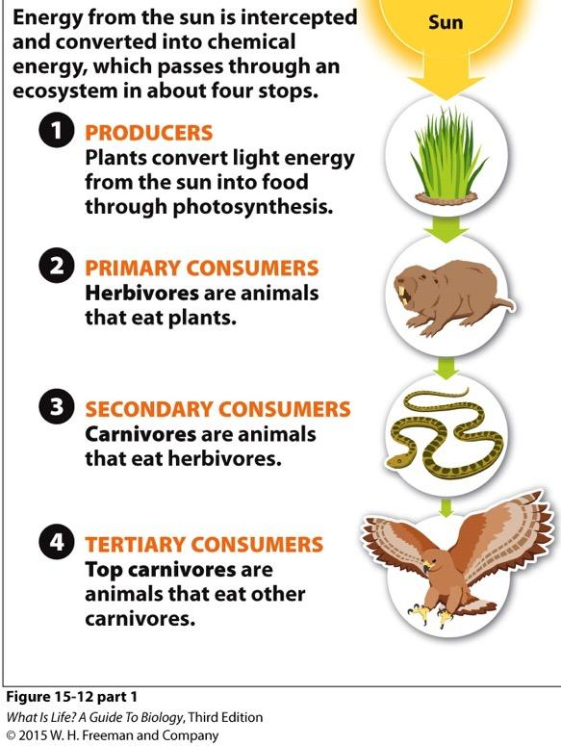
Energy Flow through an Ecosystem
Multiple species may exist at each level
Decomposers break down dead organisms to release energy stored in chemical bonds
Part of the energy cycle, but usually NOT shown in food webs

Slide 12
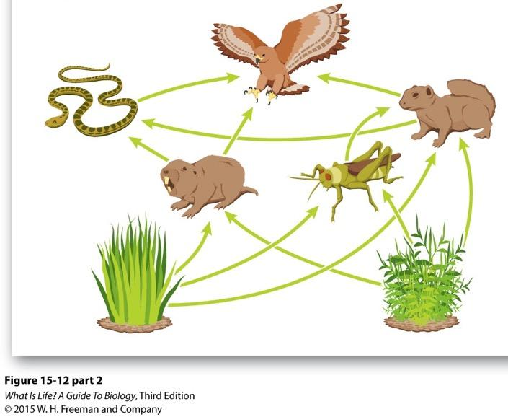
Food Webs
Energy flows are complex & involve all organisms found in an ecosystem
Organisms may serve more than one function in a food web
e.g., the hawk in this example is both a secondary & tertiary consumer
The complexity of a food web for an ecosystem depends on the diversity of organisms found in that ecosystem

Slide 13
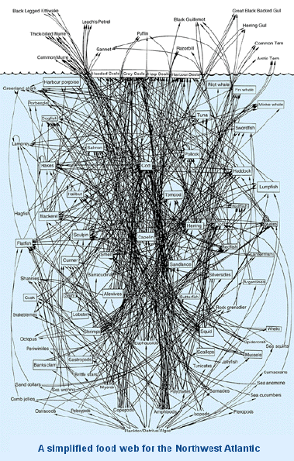
Cod
Lavigne, D. (1996) Natural Sciences and Engineering Research Council

Slide 14
Acquisition of Nutrients
Autotrophs = make own food
Producer level in food web
Herbivores = eat only plants
Primary consumer
Omnivores = eat both plants & animals
Primary consumer
Either secondary or tertiary consumer
Carnivores = eat only animals
Either secondary or tertiary consumer
Decomposers = break down dead things
Fungi, bacteria & some protists

Slide 15
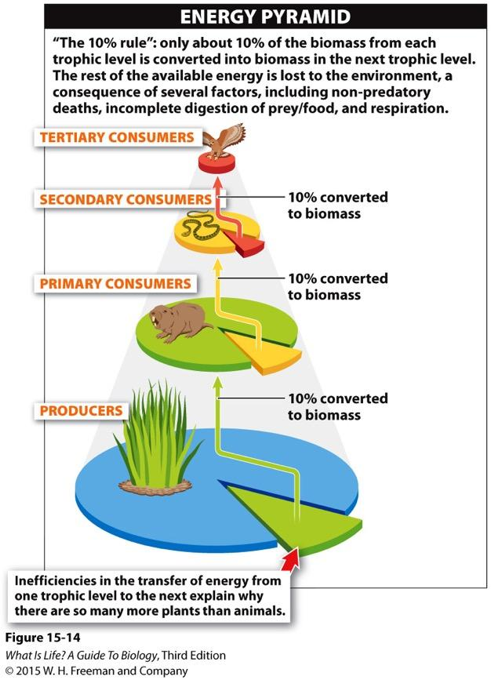
Inefficient Energy Transfer
Most energy at a given trophic level is NOT transferred to the next highest level
Can use energy requirements & availability to predict abundance
e.g., if a hawk needs 10,000 calories/year, how many calories must be produced at the primary consumer level?

Slide 16
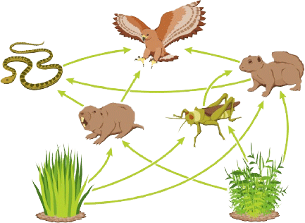
Food Web Activity

Slide 17
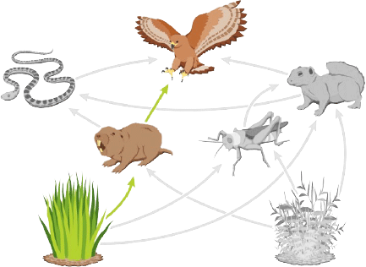
Food Web Activity

Slide 18
Food Web Activity
C
2
H
1
P
Auto

Slide 19
Food Web Activity

Slide 20
Food Web Activity
4
3
2
2
3
2
1
1
1
1
1
1
P
P

Slide 21
Food Web Activity
C
4
3
O
2
2
C
3
2
1
H
H
1
1
1
1
1
P
Auto
P
Auto

Slide 22
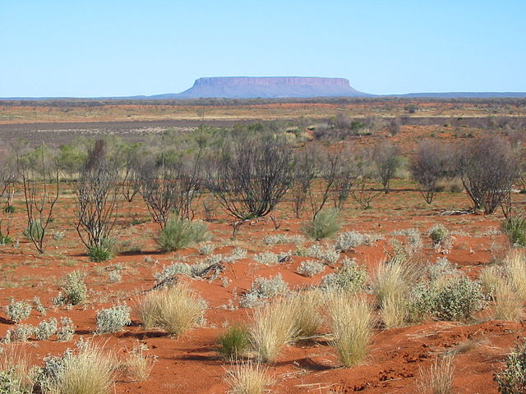
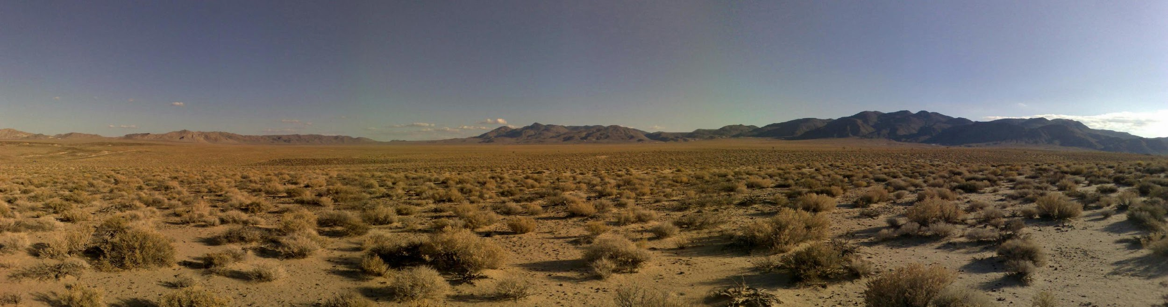
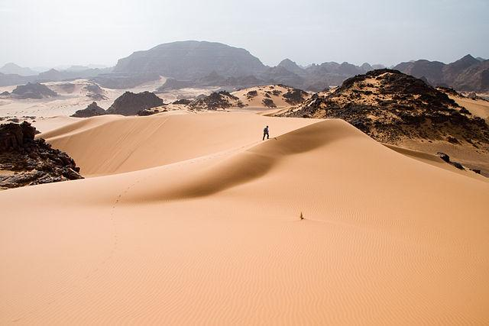
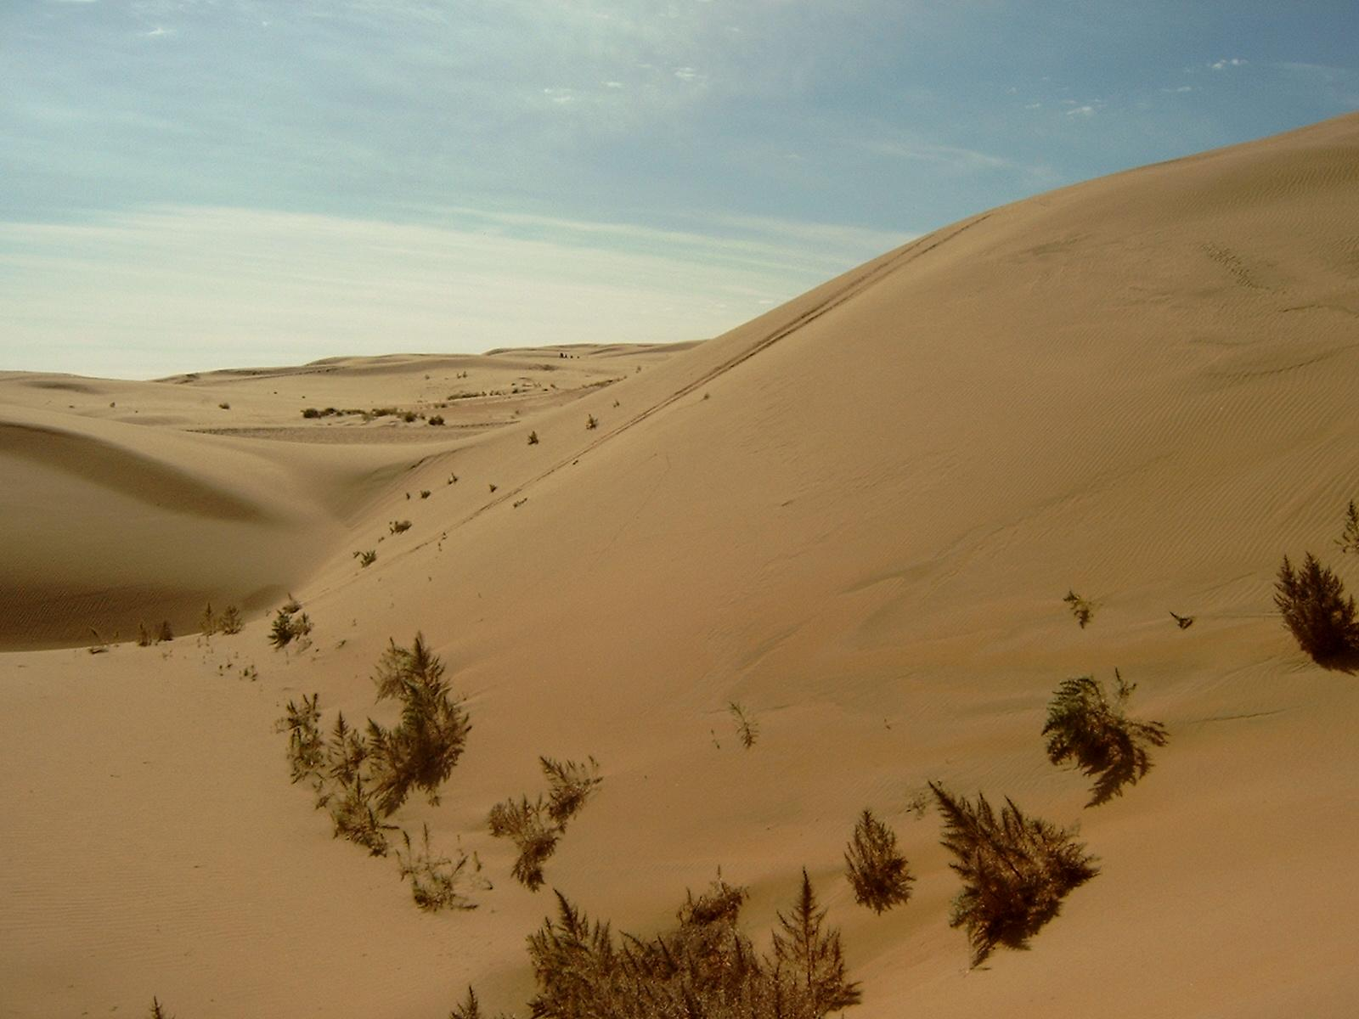
Biomes
Biomes = categories of ecosystems found on Earth
Generalizes characteristics shared by ecosystems with similar physical characteristics
Just because two ecosystems may be categorized as the same biome does NOT mean they are identical
Unique species fulfill similar roles
e.g., Mojave Desert, Sahara Desert, Gobi Desert, Australian Outback
All images from www.wikipedia.com

